Slide 1

C Programing INTRODUCTION
-NIKHIL PATIL

Slide 2
Contents
Introduction to c
Features of C
What are token’s
Keywords in C
What are Data types of C and its types

Slide 3
HISTORY
B language
C developed in 1972 by Dennis M. Ritchie
first implemented on the DEC PDP-11 computer in 1972.
formalized in 1988
keeps fluctuating at number one scale of popularity

Slide 4
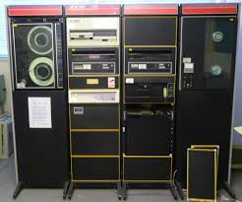
Image of DEC PDP11 Computer

Slide 5
FEATURES OF C
Middle level language
Structured programing language
Portability
Very Close to machine level

Slide 6
What are TOKENS?
Identifiers
Constants
Keywords
Strings
Special Symbols
Operators

Slide 7
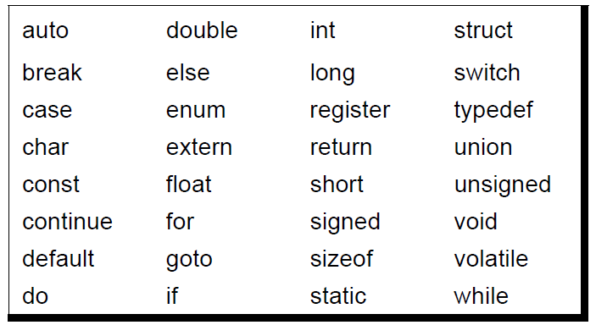
Keywords
The words whose meaning is already defined in c
There are 32 keywords in c

Slide 8
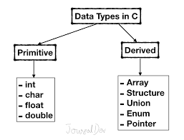
Data TYPES IN C

Slide 9
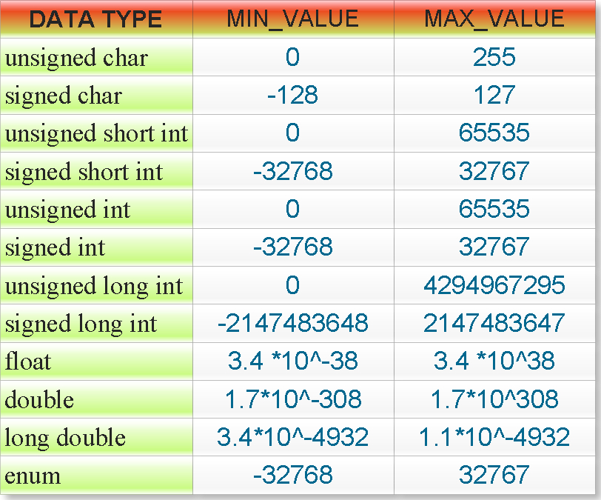
RANGE OF DATA TYPES

Slide 10
THANK YOU

